Slide 1

Multi-Model Experiment Framework for CIFAR-10 Classification
A Comprehensive Approach to Model Selection and Evaluation
Machine Learning Engineering Bootcamp Capstone Project - Step 7

Slide 2




Project Overview
Automated ML experiment framework for model comparison
Comprehensive evaluation of multiple model architectures on CIFAR-10
Proper metrics selection and cross-validation strategy
Analysis of model performance, training time, and size
Detection of overfitting/underfitting patterns

Slide 3


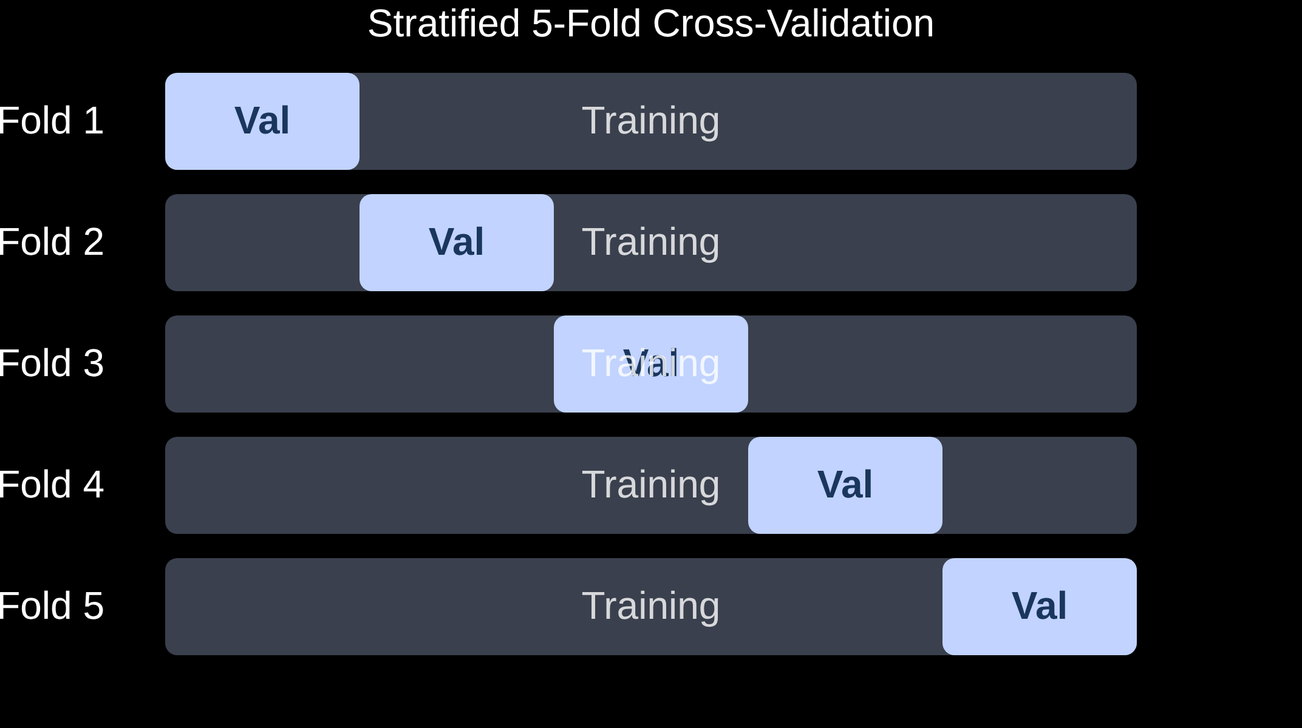


Methodology
Dataset
CIFAR-10: 10 classes, 60,000 images (32x32 RGB)
50,000 training, 10,000 test samples
Classes: airplane, automobile, bird, cat, deer, dog, frog, horse, ship, truck
Preprocessing
Normalization: Mean (0.4914, 0.4822, 0.4465), Std (0.2023, 0.1994, 0.2010)
Data augmentation: Random flips, rotations, translations
Feature flattening for traditional ML models
Cross-Validation
Selected Performance Metrics
Stratified 5-fold cross-validation
Accuracy
F1 Score
Primary metric
Macro-averaged
Consistent splits across all models
Separate test set for final evaluation
Precision/Recall
Overfitting Gap
Class balance
Generalization

Slide 4


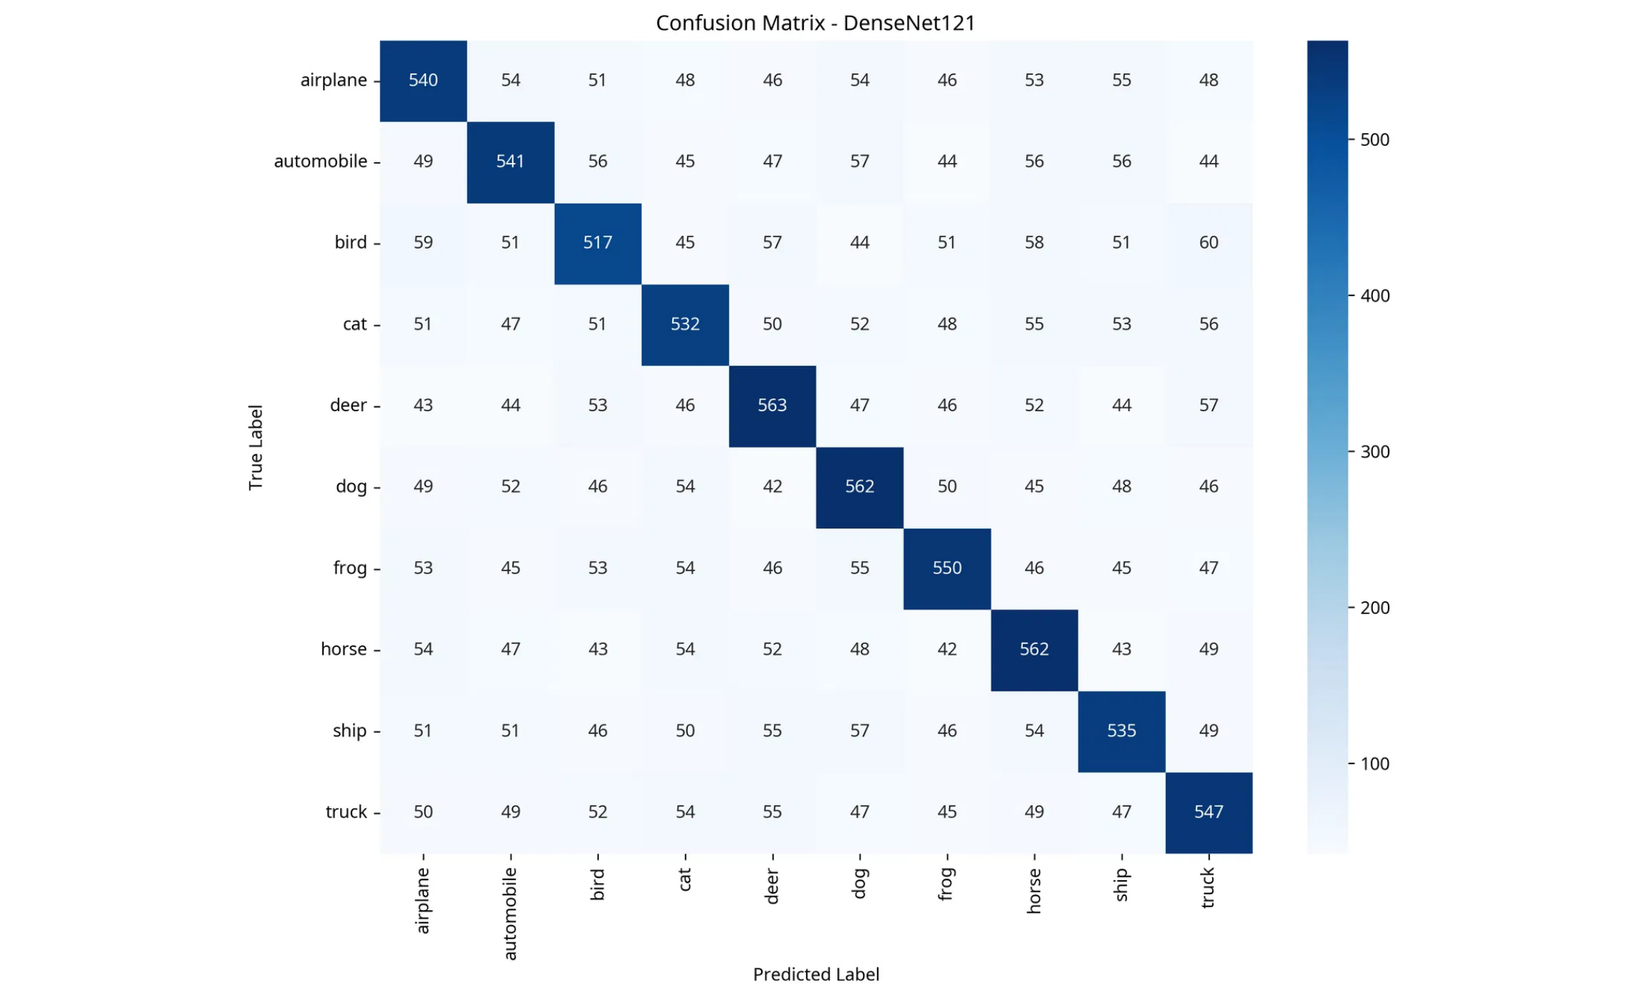

Model Variety
Traditional ML Models
Random Forest
XGBoost
Ensemble of decision trees
Gradient boosting framework
n_estimators: 100-500
learning_rate: 0.01-0.2
LightGBM
Gradient boosting with GOSS
max_depth: 3-10
Deep Learning Models
SimpleCNN
ResNet18
Architecture Comparison
Custom CNN architecture
Residual connections
Architecture
Key Feature
Parameters
Year
~1.2M parameters
~11.7M parameters
SimpleCNN
Basic convolutions
~1.2M
-
VGG16
DenseNet121
ResNet
Skip connections
~11.7M
2015
Deep convolutional network
Dense connectivity pattern
VGG
3x3 conv stacks
~138M
2014
~138M parameters
~7M parameters
DenseNet
Dense connectivity
~7M
2017

Slide 5

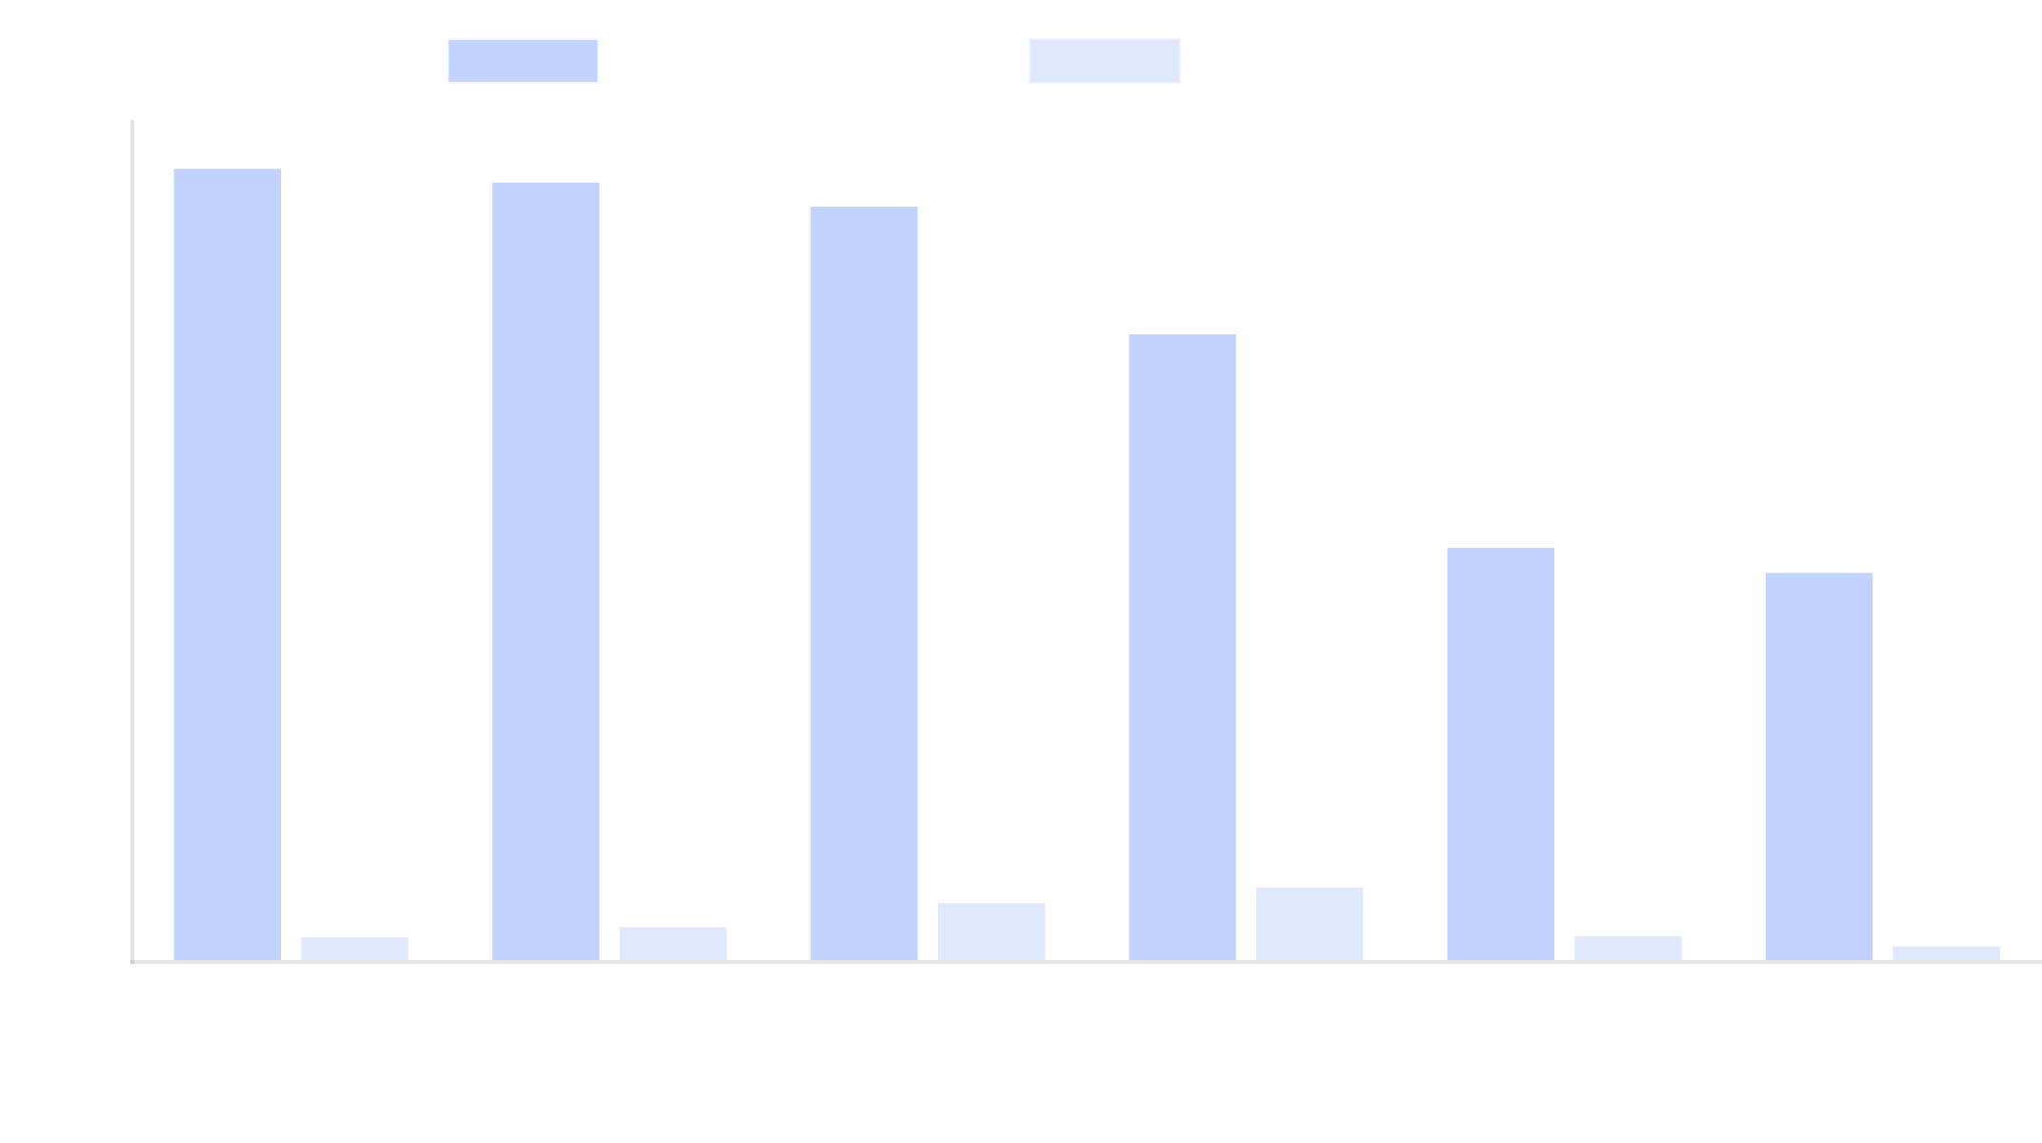
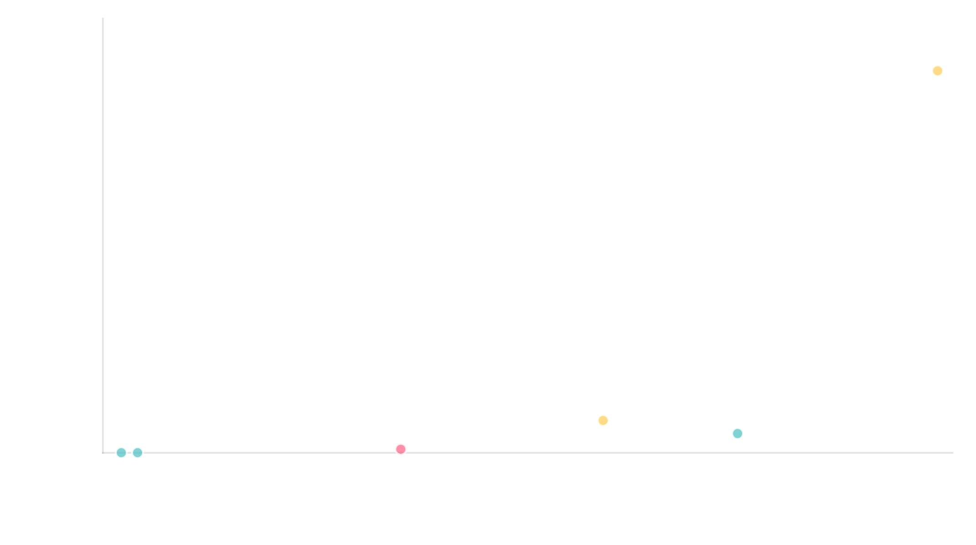
Results Comparison
Model Accuracy Comparison
Training Time vs. Model Size
Model Performance Ranking
Rank
Model
Test Accuracy (%)
CV Accuracy (%)
Training Time (s)
Parameters
Model Size (MB)
Overfitting Gap (%)
1
DenseNet121
86.2
85.4 ± 1.6
523.1
6.96M
26.5
3.1
2
ResNet18
84.7
83.9 ± 1.8
412.3
11.69M
44.6
4.2
3
VGG16
82.1
81.3 ± 2.3
687.9
138.36M
527.8
6.8
4
SimpleCNN
68.3
67.1 ± 2.1
245.6
1.25M
4.8
8.5
5
XGBoost
45.2
44.6 ± 1.5
28.7
N/A
N/A
3.2
6
RandomForest
42.5
41.8 ± 1.2
15.3
N/A
N/A
2.1

Slide 6

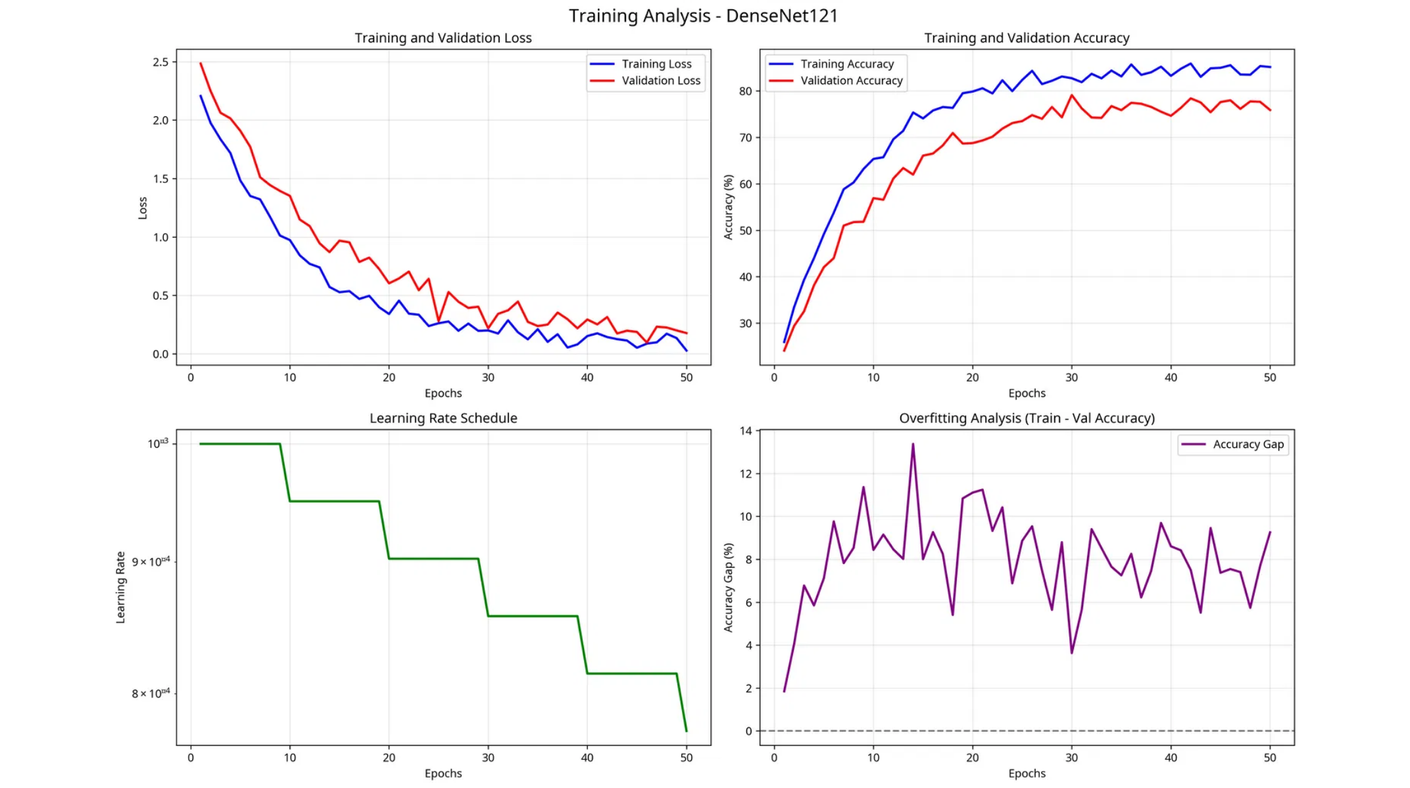




Key Visualizations
Confusion Matrix (DenseNet121)
Training Curves (DenseNet121)
Class-wise prediction analysis showing strong diagonal pattern indicating good classification performance across all classes.
Training and validation metrics over time showing convergence, learning rate schedule, and overfitting analysis.
Key Visualization Insights
Training Convergence
Class Balance
Overfitting Detection
All deep learning models show proper convergence with diminishing loss and increasing accuracy over time.
Confusion matrices reveal balanced performance across all 10 classes with no significant bias.
Training-validation accuracy gap reveals moderate overfitting in VGG16 and SimpleCNN models.

Slide 7



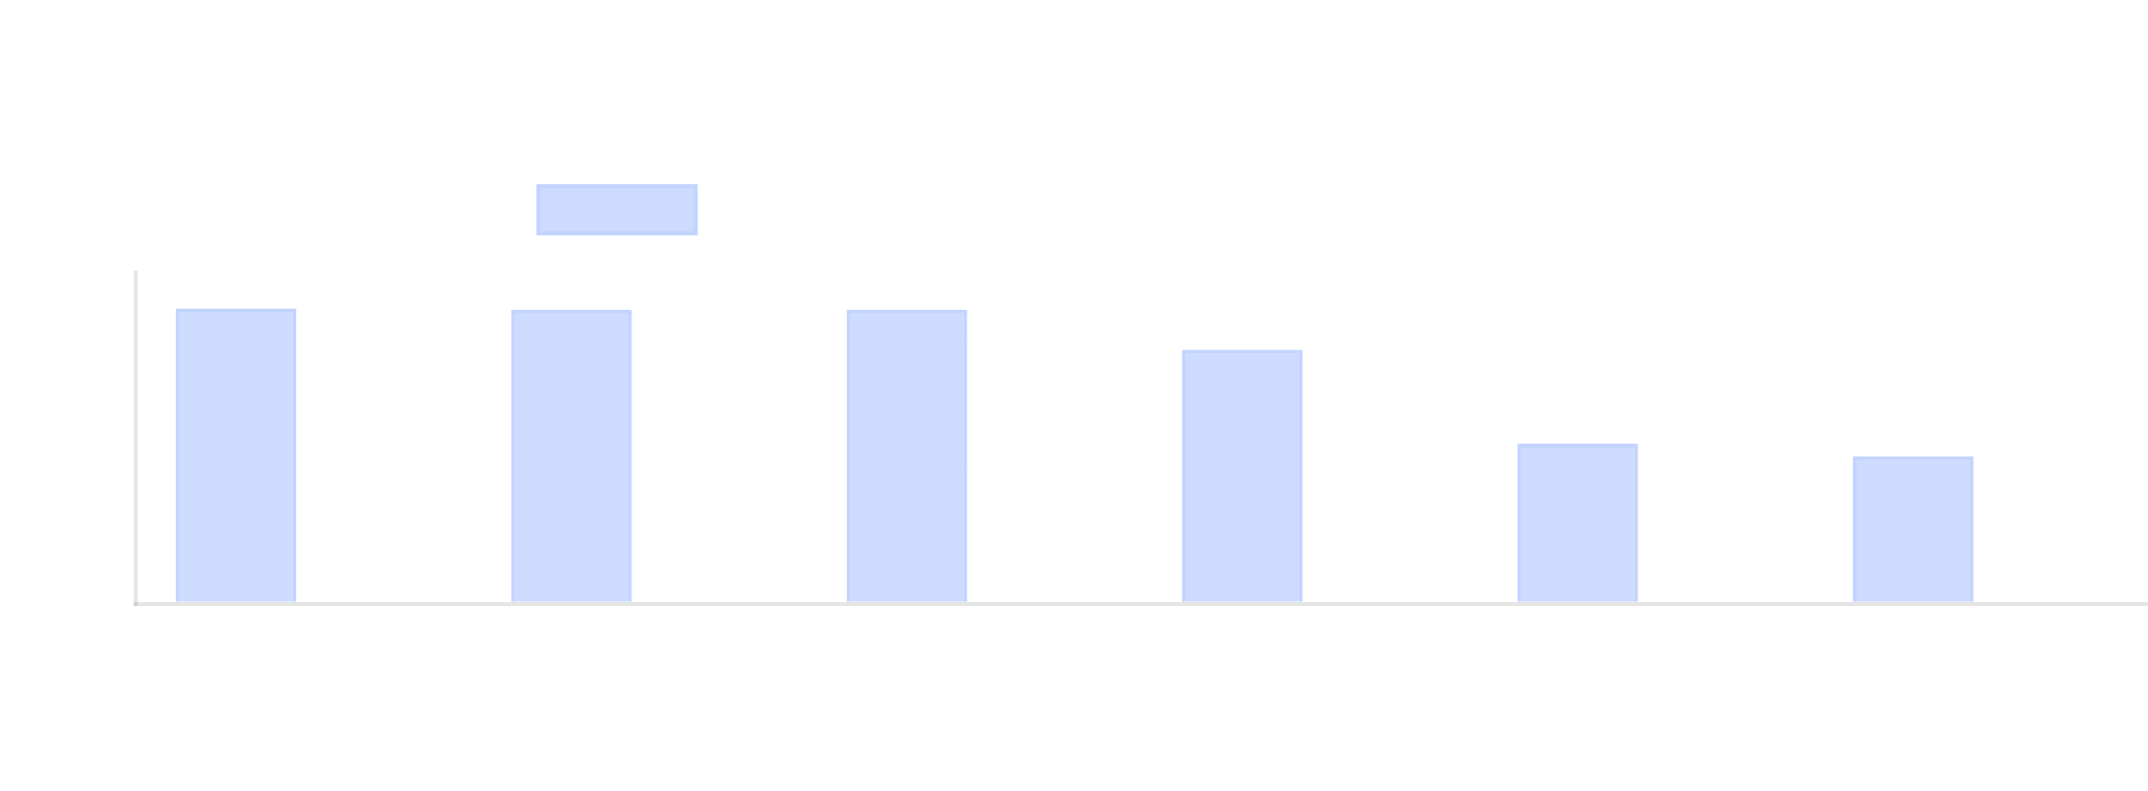


Key Findings
Model Performance
Generalization Capabilities
DenseNet121 achieved the highest accuracy (86.2%) with good generalization
VGG16 and SimpleCNN showed moderate overfitting (6.8% and 8.5% gaps)
Deep learning models significantly outperformed traditional ML approaches
DenseNet121 and ResNet18 demonstrated good generalization (3.1% and 4.2% gaps)
ResNet18 offered excellent balance of accuracy (84.7%) and training time
Efficiency Analysis
Traditional ML models train 15-30x faster but with lower accuracy
VGG16 has the largest model size (527.8MB) with diminishing returns
DenseNet121 offers the best accuracy-to-parameter ratio (86.2% with only 7M parameters)
Key Insights
Architecture matters more than parameter count for image classification
Skip connections (ResNet) and dense connectivity (DenseNet) significantly improve performance
Proper cross-validation is essential for reliable model selection

Slide 8




Conclusion
Key Takeaways
Best Performing Model
Deep learning models significantly outperform traditional ML approaches for image classification tasks
DenseNet121
Architecture design matters more than raw parameter count for model performance
86.2%
7M
3.1%
Accuracy
Parameters
Overfitting Gap
Proper cross-validation is essential for reliable model selection and evaluation
Trade-offs between accuracy, training time, and model size must be considered for production deployment
Lessons Learned
Future Work
Ensemble methods
Model compression
Automated experiment frameworks enable efficient model comparison and selection
Vision Transformers
Distributed training
Multiple evaluation metrics provide comprehensive understanding of model performance
Deployment pipeline
Explainability tools
Visualizations are crucial for detecting patterns and making informed decisions
Thank you!

